Slide 1
07 | The Power in the Shell - Remoting
Jeffrey Snover | Distinguished Engineer & Lead Architect
Jason Helmick | Senior Technologist, Concentrated Technology

Slide 2


Course Topics
Getting Started with PowerShell
01 | Don’t fear the shell | 06 | The pipeline : Deeper
02 | The Help system | 07 | The Power in the Shell - Remoting
03 | The pipeline : Getting connected | 08 | Getting prepared for automation
04 | Extending the shell | 09 | Automation in scale - Remoting
05 | Objects for the Admin | 10 | Introducing scripting and toolmaking

Slide 3
Module Overview
Overview of Remoting
Enable Remoting
One-To-One
One-To-Many
Not the end yet!

Slide 4
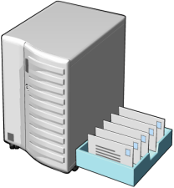


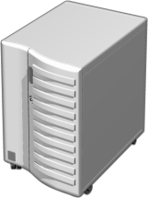





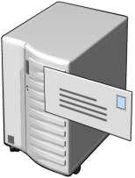
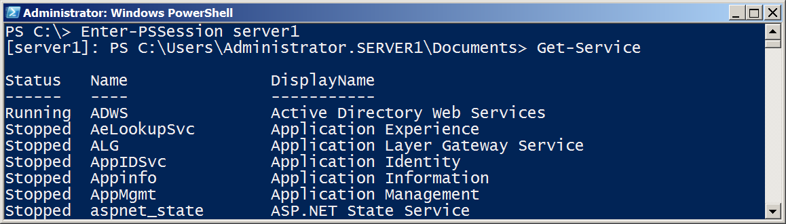
Overview of Remoting

Slide 5
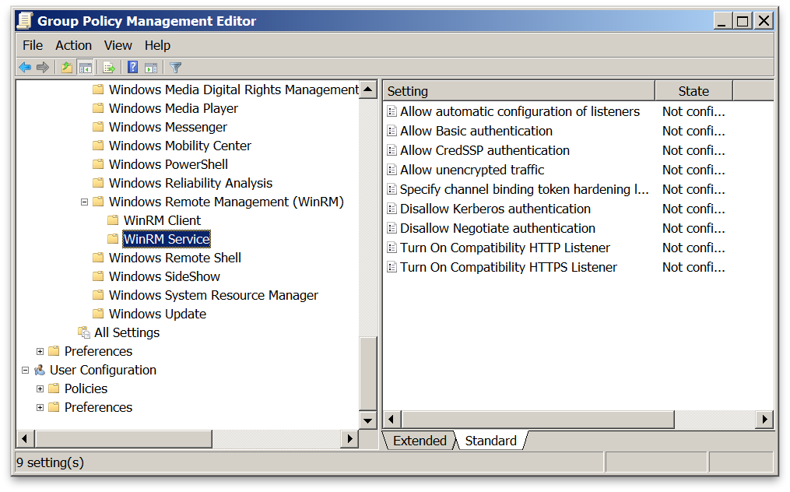
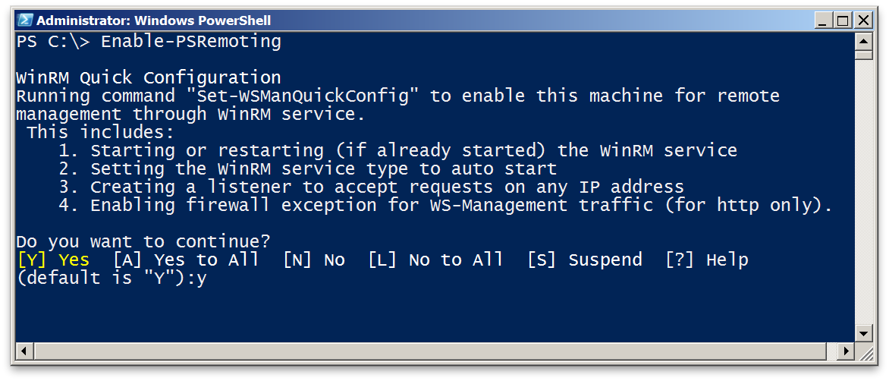

Enable Remoting
PowerShell Remoting is already enabled in Server 2012
Computer Configuration/Policies/Administrative Templates/Windows Components/Windows Remote Management

Slide 6
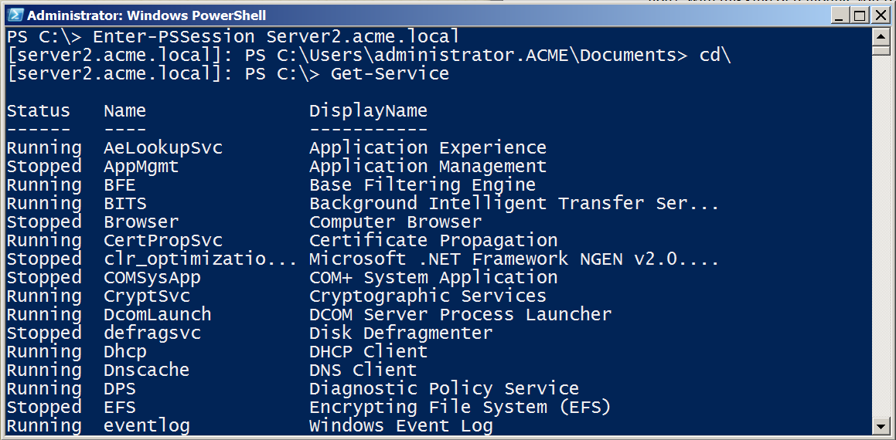
One to One - Interactive

Slide 7
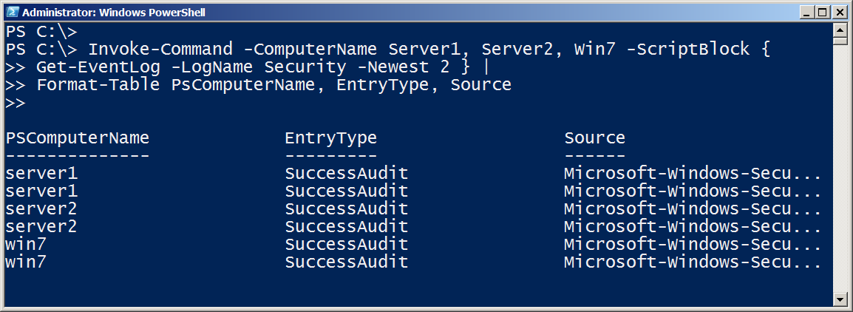
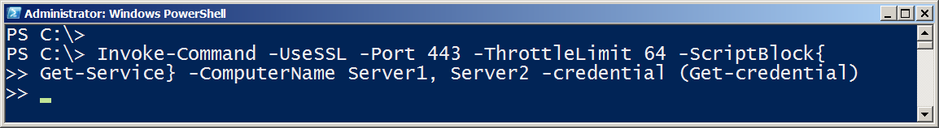
One-To-Many

Slide 8
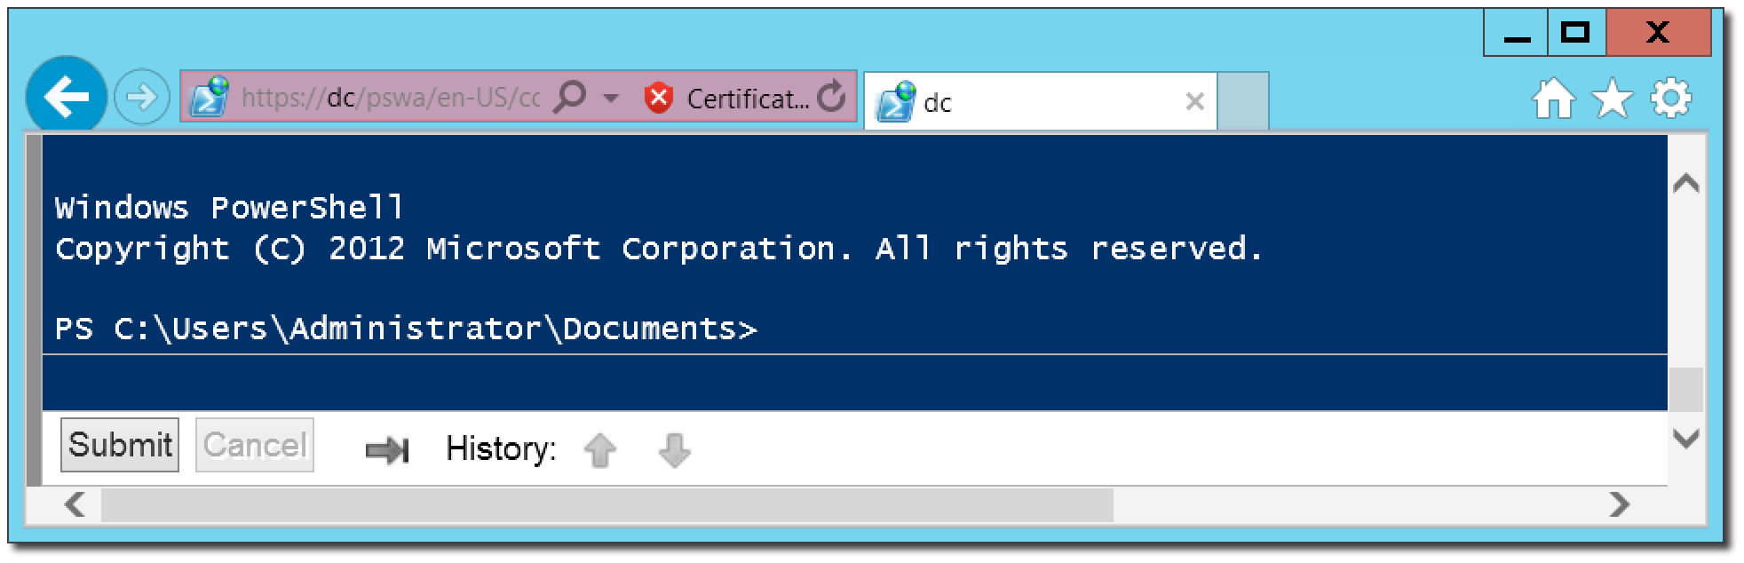
PowerShell Web Access
PowerShell – Anywhere, anytime, on any device!
Install-WindowsFeature –Name WindowsPowerShellWebAccess
Get-Help *Pswa*
Install-PswaWebApplication –UseTestCertificate
# Use the –useTestCertificate for testing (Expires in 90 days)
Add-PswaAuthorizationRule –userName <Domain\User | Computer\user> -ComputerName <Computer> -ConfigurationName AdminsOnly

Slide 9
Not the end yet!
More to come!
Managing in scale and in real time!
Automation and scripting!
Great resource: Free!
Secrets of PowerShell Remoting – Don Jones and Tobias Weltner
http://powershell.org/wp/powershell-books/

Slide 10
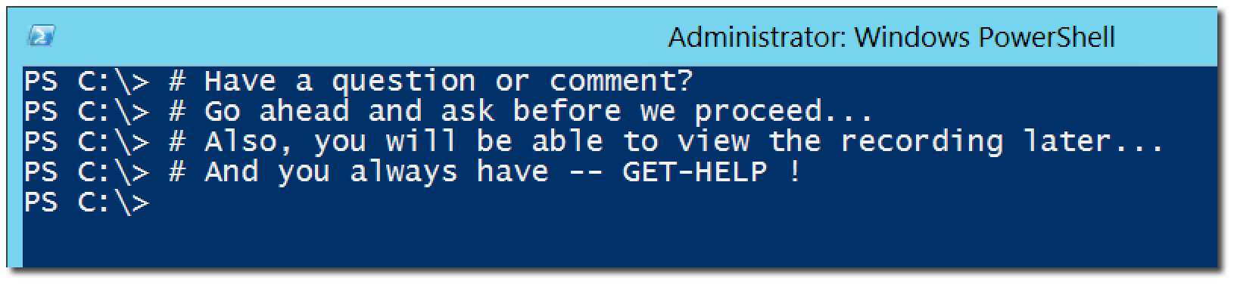
Questions or comments?

